Slide 1
Recommendation Prediction for Women’s E-Commerce Clothing Reviews
Yixuan Meng (yixuan@seas.upenn.edu)
Zhaozheng Shen (shenzhzh@seas.upenn.edu)
Zhouyang Fang (fangzhy@seas.upenn.edu)
December 08, 2021

Slide 2
Contents
Problem and Motivation
Dataset and Data Visualization
Preprocessing
Methodology
Experimental and Results
Discussion
Notes:
present it from six perspectives

Slide 3
Problem and Motivation
Motivation
Reviews of customers are essential
Text classification is reliable
Problem Formulation:
Supervised binary classification
Predict whether the reviewer recommended the product
Notes:
Reviews of customers are essential for investigating quality of products and customer’s satisfaction
Text classification is a reliable method to tell whether customers are satisfied
f1-score and ROC to measure the performance

Slide 4
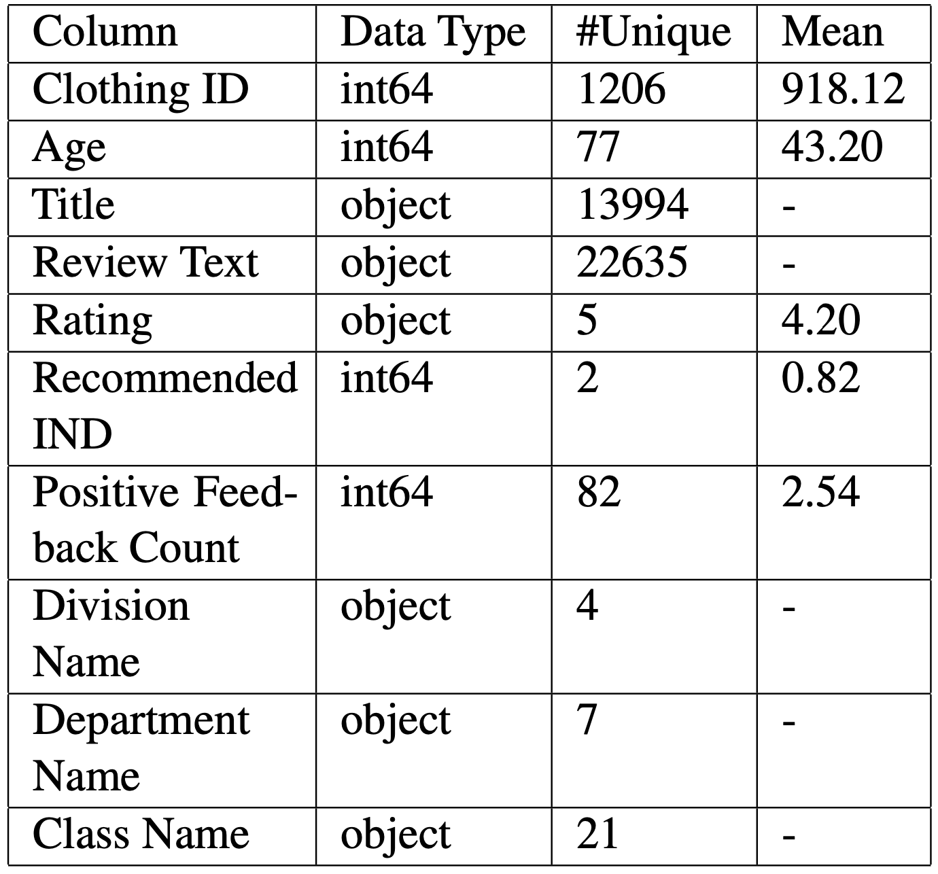
Dataset
23486 observations
10 features
Label
predict whether customers recommend a product based on the reviews they give
Notes:
brief view

Slide 5
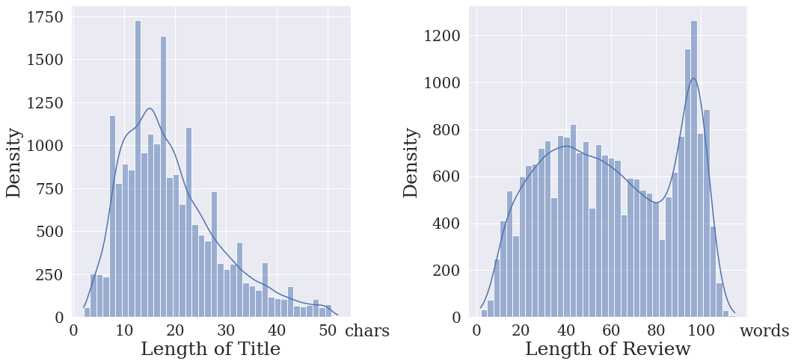
Data Visualization
Distribution of Text Length

Slide 6
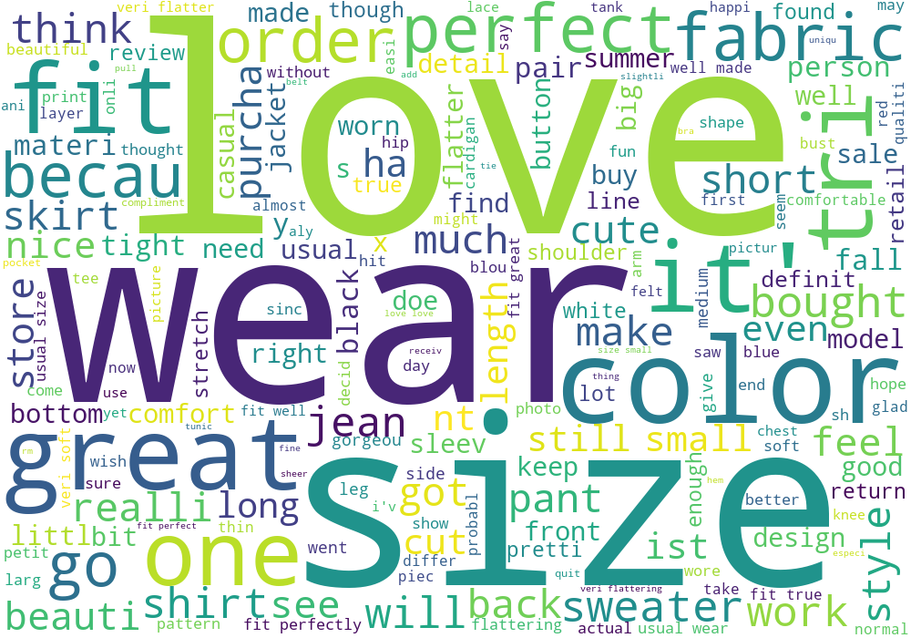
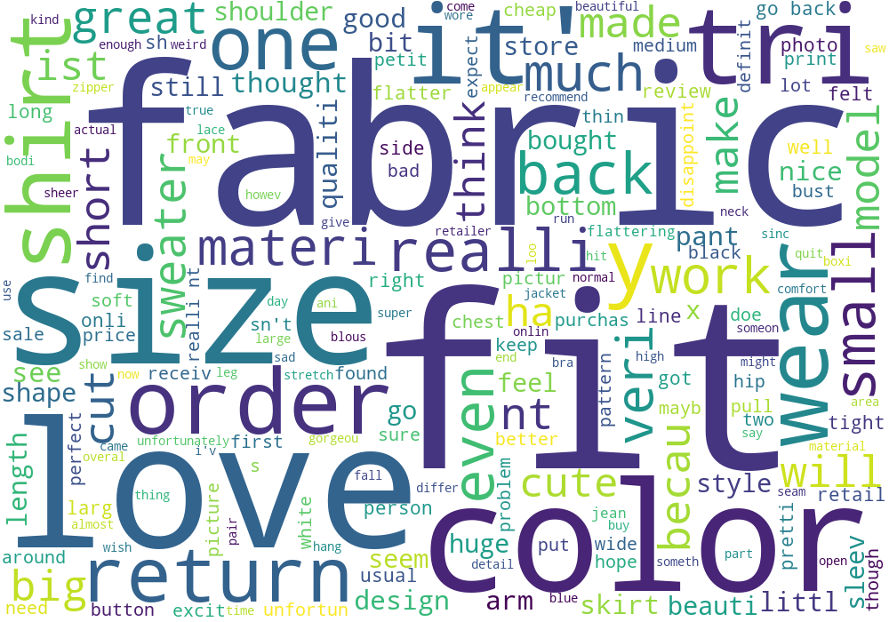
Data Visualization
Word Cloud For Positive Reviews
Word Cloud For Negative Reviews
Notes:
Count the most popular words from both sides. Words overlap for the positive and negative. This feature doesn’t tell everything.

Slide 7
Preprocessing
Create new feature:
number of times this clothing ID appears
Remove stop-words;
Create new features:
emotional polarity
text length
Label to be predicted
Create new features:
one-hot vectors for categorical variables
Notes:
Clothing ID is unique for each product.

Slide 8
Preprocessing
Use all the features expect Rating and Recommended IND
Split the dataset into
Cross Validation Set (90%, 5-fold)
pick the best hyperparameters with GridSearchCV
Testing Set (10%), compares the performance of different models

Slide 9
Methodology
Logistic Regression
SVM
Decision Tree (Baseline)
Random Forest
AdaBoost
XGBoost
Convolutional Neural Network
Pre-Trained BERT Model

Slide 10
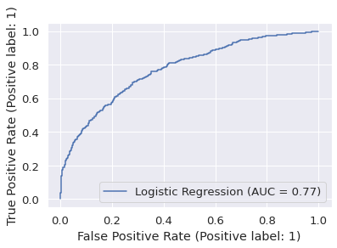
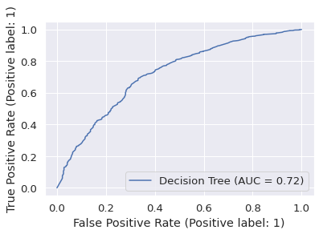
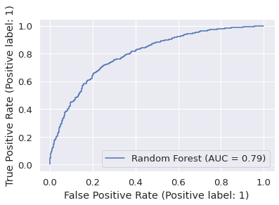
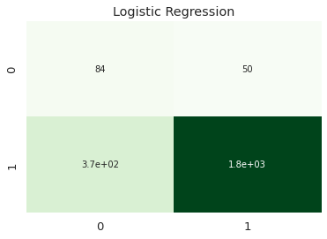
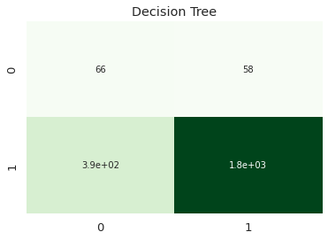
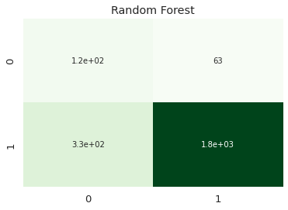
Experiments and Results
Notes:
We visualize the confusion matrix(x-axis true, y-axis pred)
decision tree area under the curve is really small
ensemble models are better: bagging and boosting are useful
roc
min_samples_split
The minimum number of samples required to split an internal node:

Slide 11
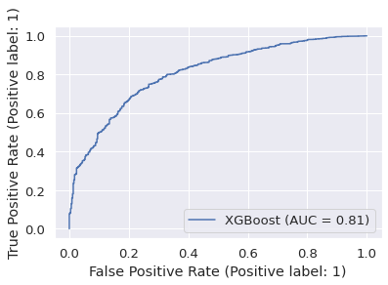
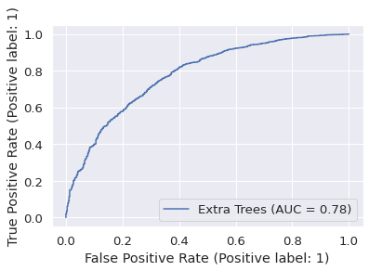
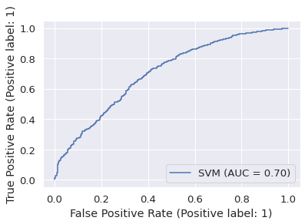
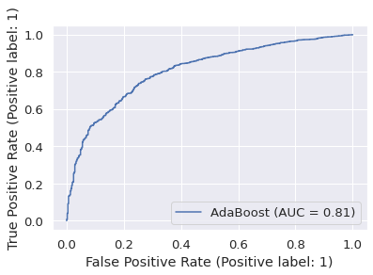
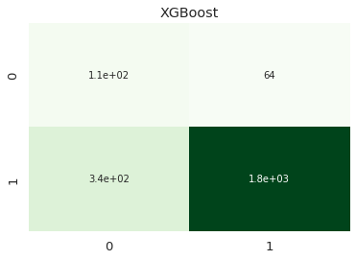

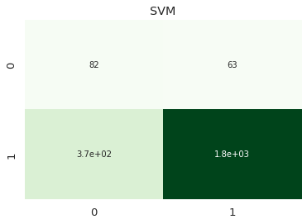

Experiments and Results

Slide 12
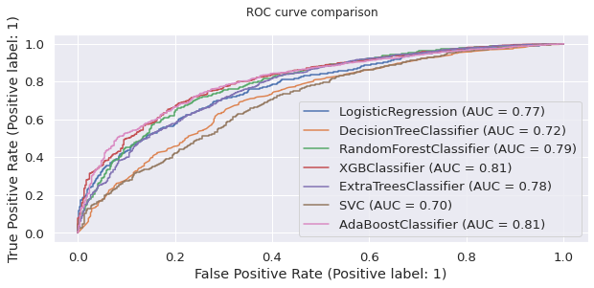
Experiments and Results

Slide 13
Experiments and Results
Convolutional Neural Network
Use oversampling to balance #0s and #1s
Use 300-dimensional GloVe embedding
Two convolutional layers
Integrate metadata by concating the output of convolutional layers and the metadata, then feed to a fully connected layer
Tune parameters (dropout rate, kernel size, hidden dimension)
Run 10 epochs with batch size 8, using Adam optimizer
The accuracy on validation set is 82.42%
Notes:
Evaluation
𝐹₁ of the learned edges compared to the gold standard edges
𝐹₁ for the set of propositions inferred from the learned graph, compared to the set inferred based on the gold standard graph
Note: final score for an algorithm is a macro-average over the 12 graphs of the test set
Details
Local-LP: omitting global transitivity constraints
Local₁ (w/o *) v.s. local₂ (w/o *): Lin similarity function or Binc similarity function
Locals v.s. Local*s: the best similarity function or all similarity functions

Slide 14
Experiments and Results
Transfer learning – Pre-trained BERT
Use BERT (large-uncased) from Huggingface
Use BERT tokenizer to generate Token embeddings, Segment embeddings, and Position embeddings
Feed the output of the BERT model to fully predicted layer
Create a schedule to decrease learning rate after certain #epoches
The accuracy on validation set is 88.38%
Notes:
token embedding convert words to vectors with certain dimension
segment embedding is used to tell sentences apart
position embedding: do self-attention to which words

Slide 15
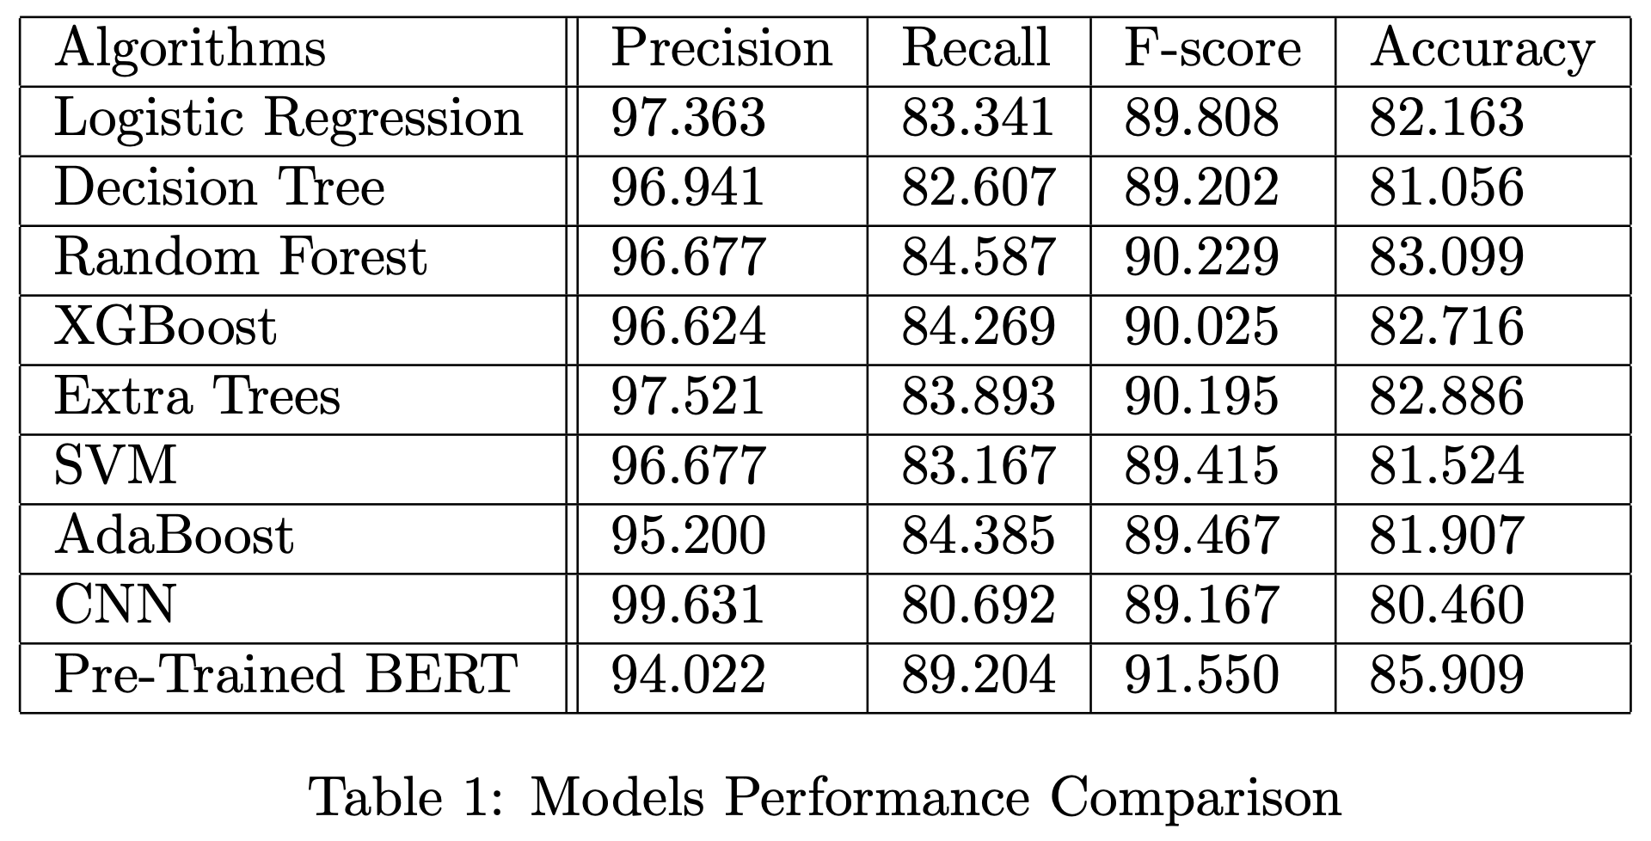
Experiments and Results

Slide 16
Thanks!

